Slide 1
Affordable mobile application camera system to monitor residential societies vehicle activity
PIP104 PROFESSIONAL PRACTICE-II
VIVA-VOCE
Batch Number:99
Under the Supervision of,
Dr. Nasurudeen Ahamed.N
Associate Professor(Sr.Gr)
School of Computer Science Engineering & Information Science
Presidency University
 | Roll Number | Student Name
 | 20201CSE0548 | Madan Kumar S L
 | 20201CSE0562 | Avinash
 | 20201CSE0579 | T N HARISH

Slide 2
Abstract
"SocietySafeDrive" introduces a cost-effective vehicle monitoring solution tailored for Indian residential communities. Combining image processing technology and a user-friendly mobile app, the system accurately identifies vehicles and swiftly notifies residents of arrivals and departures, fortifying overall security measures.
The process involves the system has still images as the input, and extracts a string corresponding to the plate number, which is used to obtain the output user data from a suitable database. The system extracts data from a license plate and compare it with the user database if it matches the it will store the details of that vehicle and if it is not matched means that while does not belong as that society then it will generated a message and send it to the culministrator. License plate extraction is based on plate features, such as texture, and all characters segmented from the plate are passed individually to a character recognition sage for reading.

Slide 3
Introduction
Residential security is a pressing concern for homeowners and communities worldwide. Traditional security measures, such as physical guards or static surveillance systems, have limitations in terms of cost, accessibility, and effectiveness. Mobile application camera systems, equipped with real-time monitoring and remote accessibility, have emerged as a viable solution to address these challenges. This literature review explores the significance and benefits of mobile application camera systems in enhancing residential security.
Enhance Residential Security: Introducing a cost-effective mobile application camera system to bolster the security of your residential community.
Remote Accessibility: Access live video feeds and recorded footage from your mobile device or computer, ensuring you can monitor your society's security from anywhere.
Real-Time Alerts: Receive instant alerts on your mobile device when unusual or unauthorized vehicle activity is detected, ensuring swift action and peace of mind.
Vehicle and Visitor Monitoring: Easily track all vehicle and visitor activity, helping identify and manage authorized and unauthorized access.

Slide 4
Literature Review
Title of the paper & Year of Publication. | Key Contribution. | Problem Addressed. | Proposed System.
A technique for developing mobile applications(2020) | It provides Regular Updates for the users. | Compatibility problem for different platform. | Proposed by different framework And platforms
On secret management and handling in mobile application development life cycle(2019) | It methods for handling and maintaining secrets when creating mobile apps. | Poor input validations and commands. | Managing secrets in the life cycle of software development with an emphasis on mobile apps.
Embedded Mobile ROS Platform for SLAM Application with RGB-D Cameras (2020) | To map the environment using the data captured by the RGB-D camera. | Due of its interoperability with the Robot Operating System (ROS), it was chosen. | An autonomous, self-driving, tracked vehicle is the suggested system.

Slide 5
Literature Review
Title of the paper & Year of Publication. | Key Contribution. | Problem Addressed. | Proposed System.
Implementation of number plate detection system for vehicle registration using IOT and recognition using CNN(2023). | Detect and localize a license plate in an input image/frame. | Extract the all characters from the license plate. | Apply some form of Optical Character Recognition (OCR) to recognize the extracted characters.
Mobile Registration Number Plate Recognition Using Artificial Intelligence(2021). | checking if a vehicle is registered or licensed. | Need the support of Artificial intelligence. | To distinguish vehicles by recognizing number plates.
Automatic number plate recognition system for Indian number plates using machine learning techniques(2022). | The images taken by the camera are converted into text format. | All characters of the number plate are recognized. | OCR (Optical char- acter recognition) algorithm.

Slide 6
Objectives
The objectives of developing an affordable vehicle monitoring and identification system for residential societies are aimed at enhancing security, improving convenience for residents, and providing efficient vehicle management within the community. Here are the key objectives:
1. Visitor Tracking: Implement a system that not only monitors residents' vehicles but also tracks and records information about visitors and their vehicles, enhancing overall security and visitor management.
2. Security Alerts: Develop a system that can provide frequent security alerts to residents, such as vehicle-specific notifications or alerts based on resident preferences and concerns.
3. Secure Remote Access: Ensure that the mobile application and the system have robust security features, including two-factor authentication, to prevent unauthorized access to video feeds and data.
4. Access Control Integration: Integrate the mobile application with access control systems to ensure that only authorized residents and vehicles can enter the community.
5. Feedback and Improvement: Use the system to collect feedback from residents on security concerns and continuously improve security measures based on community input.

Slide 7
Proposed Method
To design an affordable vehicle monitoring and identification system for residential societies, we'll integrate image processing for vehicle identification with a mobile application for notifications and analytics. Here's a proposed method:
Image Acquisition
Vehicle Identification using Image Processing
License Plate Matching and Resident Identification
Database Management
Mobile Application Development
User Registration and Profile Setup
Real-time Vehicle Alerts and Notifications.
Analytics and Reporting

Slide 8
Existing Methods And Drawbacks:
Certainly! Here are some existing methods for vehicle monitoring and identification systems along with their drawbacks:
1. Camera-Based Systems:
Method: Relies on cameras at entry/exit points for vehicle identification.
Drawbacks: Limited accuracy in adverse weather conditions or low-light environments.
Susceptible to image distortion, affecting license plate recognition.
High dependency on camera quality and angles for effective identification.
2. RFID-Based Systems:
Method: Uses RFID tags or stickers for vehicle identification.
Drawbacks: Costly implementation due to RFID tag expenses and infrastructure setup.
Limited range and difficulty in reading tags at high speeds or congested areas.
3. Infrared Sensors:
Method: Measures infrared emissions from vehicles for detection.
Drawbacks:
Limited accuracy in distinguishing vehicle types or specific identification.
Susceptible to false positives from non-vehicle infrared sources.

Slide 9
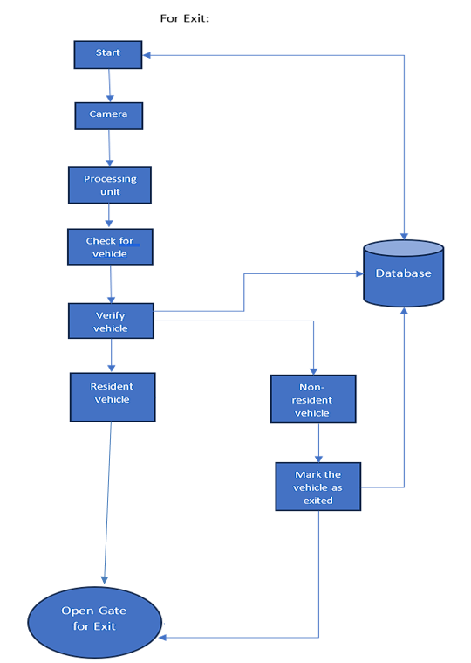
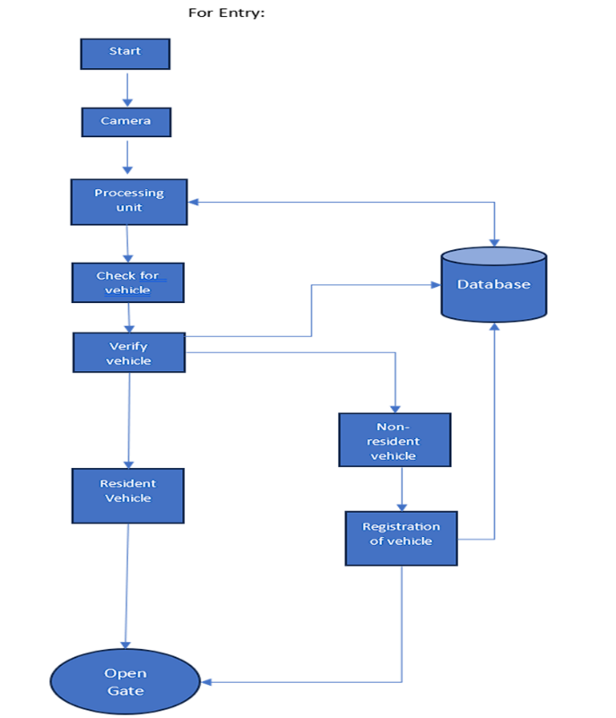
Architecture Diagram:

Slide 10
Expected Outcomes
The app can help to deter unauthorized vehicles from entering the premises, identify vehicles that are involved in criminal activity, reduce congestion by identifying vehicles that are parked in inconvenient or unsafe locations, improve traffic flow by providing real-time information about vehicle activity, and give residents peace of mind knowing that their community is being monitored.
Here are some specific benefits that you can expect to see from using a mobile app to monitor residential societies vehicle activity:
Reduce vehicle theft
Visitor Management
Improved safety
Cost-Effective Surveillance
Increased peace of mind

Slide 11
Software Components
Here's a breakdown of the software components that might be involved in implementing the "SocietySafeDrive" vehicle monitoring and identification system:
1.Operating System:
Windows / Linux.
2.Development and Integration:
Python: Programming language for system development and integration.
Easy OCR: Optical Character Recognition library for precise character recognition.
3.Database Management:
Relational Database Management System (RDBMS):Used Firebase for storing and
managing number plate and user information.
4.Mobile Application Development:
Mobile App Development Framework: Flutter for creating the designated mobile
application for security personnel.

Slide 12
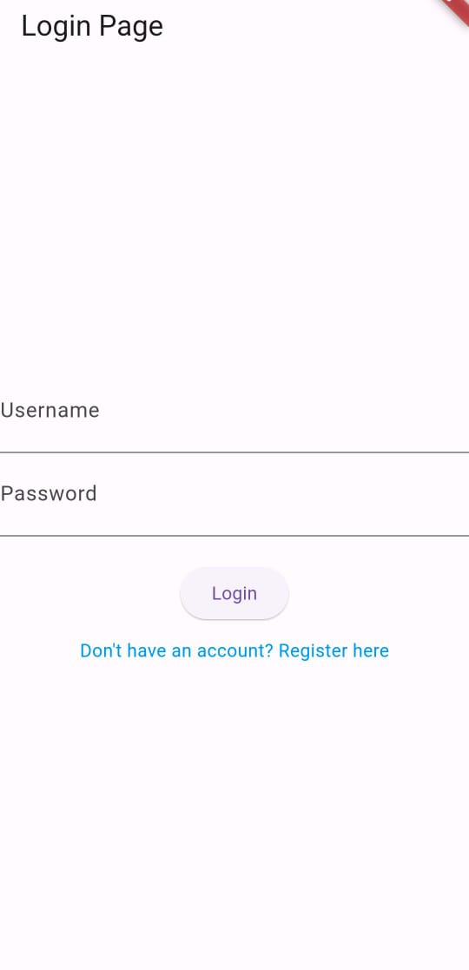
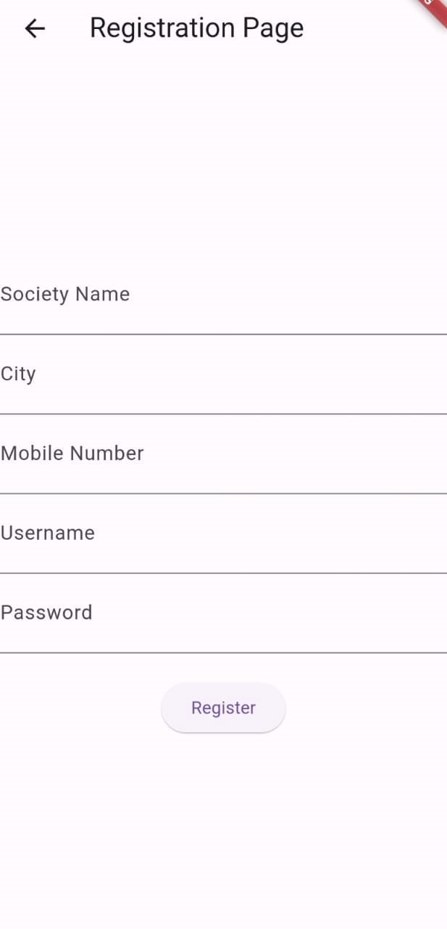

User Interface

Slide 13

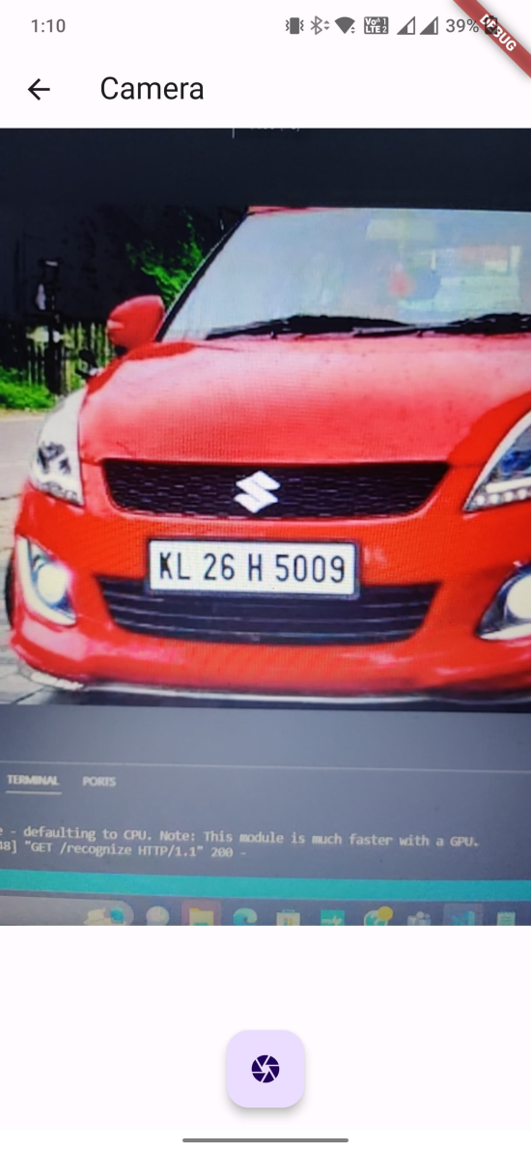
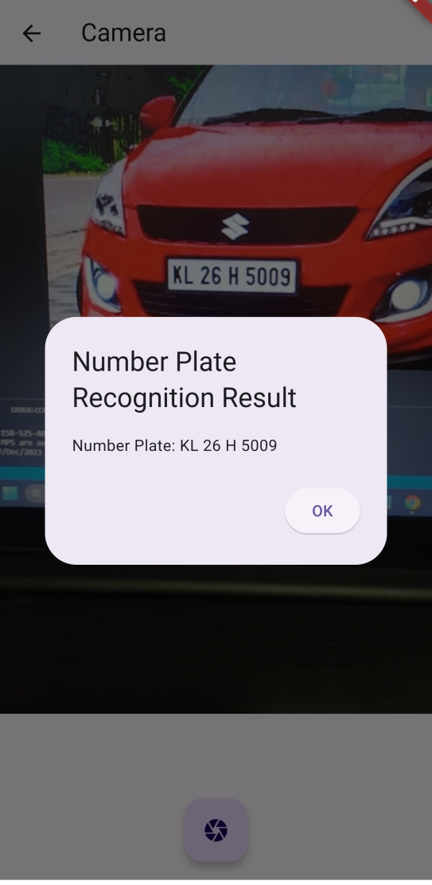
User Interface

Slide 14
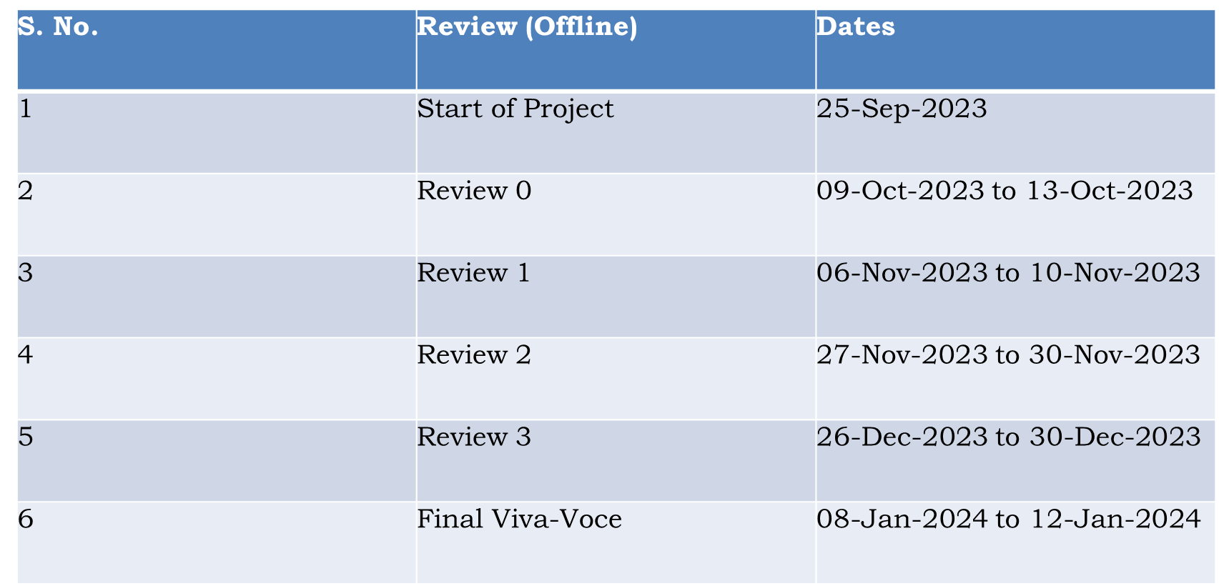
Timeline of Project

Slide 15
References
Henry, C., Ahn, S. Y., & Lee, S. W. (2020). Multinational license plate recognition using generalized character sequence detection. IEEE Access, 8, 35185-35199.
Shashirangana, J., Padmasiri, H., Meedeniya, D., & Perera, C. (2020). Automated license plate recognition: a survey on methods and techniques. IEEE Access, 9, 11203-11225.
Weihong, W., & Jiaoyang, T. (2020). Research on license plate recognition algorithms based on deep learning in complex environment. IEEE Access, 8, 91661-91675.
Rohit Sahay, Mayur Waghela, Abhishek Mulgaonkar, Vansh Tiwari, & Lect. A.P.Shinde. (2022, April). QR CODE GENERATOR USING PYTHON. International Journal of AdvancedResearch inComputer and Communication Engineering, 11(4). https://doi.org/10.17148/IJARCCE.2022.114201
Jawale, M. A., William, P., Pawar, A. B., & Marriwala, N. (2023). Implementation of number plate detection system for vehicle registration using IOT and recognition using CNN. Measurement:Sensors, 27, 100761.
Bourahla, A. E., & Bourahla, M. (2020, December). A technique for developing mobile applications. In 2020 4th International Symposium on Informatics and its Applications (ISIA) (pp.1-5). IEEE.
Al-Shemarry, M. S., & Li, Y. (2020). Developing learning-based preprocessing methods for detecting complicated vehicle licence plates. IEEE Access, 8, 170951-170966.

Slide 16
References
He, M. X., & Hao, P. (2020). Robust automatic recognition of Chinese license plates in natural scenes. Ieee Access, 8, 173804-173814.
Chandankar, B. R., Choudhari, R. S., Nagrale, S. M., Morey, P. D., Nikhade, P. G., &amp;Nagrale, Prof. V. (2019, December). Affordable Mobile Application to Monitor Residential Society’s Vehicle Activity. chandrapur; IOSR Journal of Engineering (IOSRJEN).
Shi, H., & Zhao, D. (2023). License Plate Recognition System Based on Improved YOLOv5 and GRU. IEEE Access, 11, 10429-10439.
Zou, Y., Zhang, Y., Yan, J., Jiang, X., Huang, T., Fan, H., & Cui, Z. (2020). A robust license plate recognition model based on bi-lstm. IEEE Access, 8, 211630-211641.
Puli, M. S., Surarapu, M. S. S., Sudheshna, M., Gayathri, G., Sejal, S., Varun, K., & Reddy, G. H. (2023). License Plate Image Analysis Empowered By Generative Adversarial Neural Networks (GANS). Journal of Survey in Fisheries Sciences, 2693-2698.
Al-Shemarry, M. S., & Li, Y. (2020). Developing learning-based preprocessing methods for detecting complicated vehicle licence plates. IEEE Access, 8, 170951-170966.

Slide 17

Thank You

